Slide 1

Innovation Engineering
User Rating: 1-5 Stars
Date: mm/dd/yyyy
Technology Tool Evaluation
Name(s)
Technology Strategy
You may use a different slide template
Notes:
Created Spring 2020

Slide 2
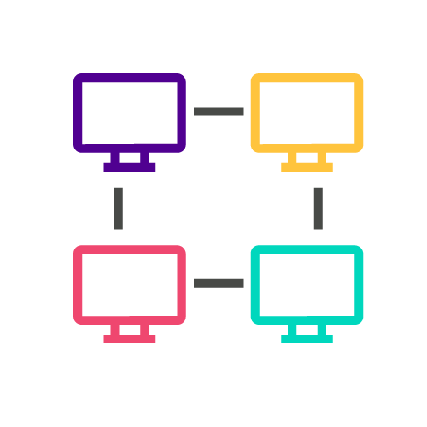
Colt-X: The Use of AI for Network Automation and Network Optimization
Colt Technology Services
Berkeley Innovation X-Labs
Sutardja Center for Entrepreneurship & Technology
Notes:
Hello and welcome to Berkeley Innovation-X Labs project in collaboration with Colt Technology Services. Our team is currently exploring the use of AI for network automation and optimization.

Slide 3
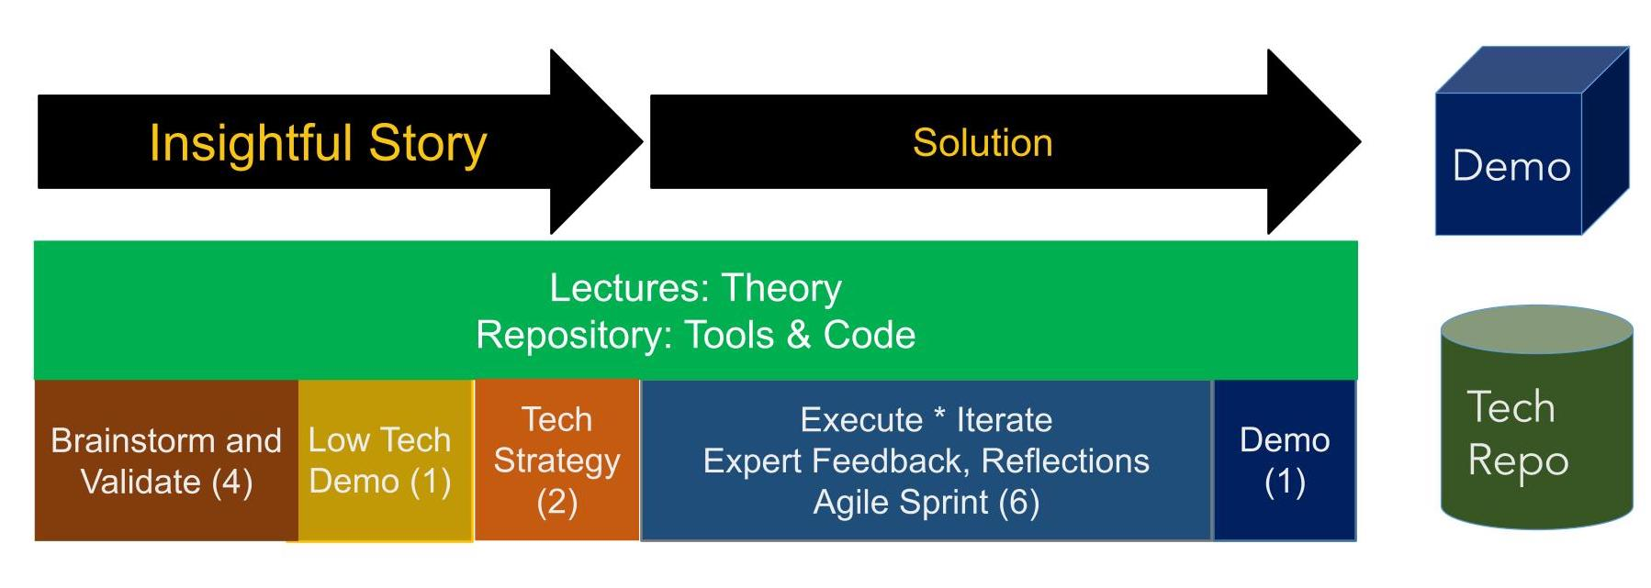
Innovation Engineering: How it Works:
Open-ended, real-world project: Typical team size is 5 plus mentor network
Notes:
We are now adding tech strategy into the model – it is part of the “story”
The formulation of the course is also very powerful.
We will mimic 14 week version in 2 days, best we can – and add executive/lead.ership content on top of that
Your project; develop the low tech demo: build the rest after this class.
Resources for later.

Slide 4
Anvil
UC Berkeley SCET Innovation X-Labs collaboration with COLT Technology Services.
SITUATION- Applied research project on the use of AI for network optimization.
NEED FROM TOOL/PLATFORM- Create UI to display automatic network bandwidth setting through data visualizations of network traffic and mean bandwidth + dynamic characterizations of SLA.
WHY ANVIL- Iterate on front-end web application using Python, allowing the user (COLT) to upload network traffic data files and connect existing algorithm settings. Deploy anywhere.
Student teams can collaborate through Git version control or generating private link to send.
Provided link to create FREE license for Berkeley.
Can use with Jupyter (relevant for future X-Labs scholars through coursework and projects).
Notes:
Can present on Wednesday
The type of traffic (application - AR/VR) shouldn’t be considered on this UI since we should be making a prediction regardless of what application it is. This is because in the actual use case, it’s unclear/unknown as to what the application is. We should just focus on which link and QOS are the ones of interest. Through this mechanism, some proposals are made for a new bandwidth.
Take some data that comes from the network to understand how it’s serving the QOS and then propose what needs to be done. Figure out whether we want to increase or decrease the limit assigned on that link (dynamic part).
Imagine a screen with a different application that’s predicting what you should do for the second application. We can assume each is a separate link, determine how much bandwidth you want, and in the end, add all the individual bandwidths to set the total bandwidth (sum).
Increase bandwidth for that specific application, not the link overall. Such as, one service can be using 1/3rd, another can be using 2/3rd.
The network is able to understand the specifics of the application. They want us to deliver its dynamic SLA based on real time.
user input features (what the bandwidth is currently set to as part of current network settings, specify qos levels as low/mid/high and assign those qos measures to some beta value, specify network, ability to select specific link that you would like to adjust bandwidth for)
some links might be running multiple applications so we need to specify the type of input data: ar/vr application
characterization: map the application traffic data to qos level (return as part of output)
total (optimized) bandwidth=sum of what current bandwidth is set to and all adjustments made (increase or decrease)=output as int
algorithm: adjust the bandwidth and it fills and again " until the application network settings on edge of link reaches sufficient bandwidth for qos measure (max out until it is set high enough so traffic never sees boundary)
define test: has to be something pulling the bandwidth down so we need to keep trying to drop it with each adjustment we make (check for optimal bandwidth setting)
output: line plot of mean network traffic over one minute intervals with two horizontal lines representing current and optimized bandwidth, current suggested bandwidth and optimal (adjusted) bandwidth, characterizations (descriptive statistics) and qos measure (assigned to some beta value)

Slide 5
The Purpose of the Anvil UI
Determines a new Bandwidth
Allows Colt to upload data files that automatically:
displays automatic network bandwidth settings through data visualizations of network traffic and mean bandwidth and dynamic characterizations of SLA.
Gives Mean Network traffic of the Current Bandwidth each Minute on a line graph
Chooses the target app from VR, to AR
Pick QOS Level from low , median, high
checkbox for raw data
Has a characterization table and a Network Traffic for VR
Has a summary graph of the data

Slide 6
Compare to Streamlit
 | Flexibility / Speed of Iteration | Ease of Use / Learning Curve | Performance. How does it scale with more usage | Overall rating Effectiveness for Problem
Streamlit | quick | easy. intuitive documents; basic python coding | good for data analysis/display (without heavy user interaction features) | 7
Anvil | quick | medium. has video and documents; more components(client codes & UI) | good if we need heavy backend codes/more features/user interaction/pipeline; not as nice UI as Streamlit | 9
Notes:
can present on Wednesday

Slide 7
Economic and IP Evaluation
 | Cost to Use. How does it scale? | IP Issues. Can it be used in a product? | Comments
Streamlit | Free | None | Easy to learn and grasp from the Web Has a better UI system
Anvil | free licence at Berkeley or else it is paid | None | Need to learn a lot more, and watch videos. Hard to create a perfect UI system. Can upload data

Slide 8
Trade-offs on the UI
1 Situation/Objective in 1 phase/sentence:
Good Points of this tool/platform:
Show data visualization of network traffic, mean bandwidth, and dynamic characterization that allows COLT to upload network traffic data files and connect existing algorithm settings
allow you to manage both UI & client codes
Bad Points of this tool/platform:
Can’t project the time in graphs for hours, day, year
Hard to display nice UI components
Notes:
can present on Wednesday

Slide 9
Your Review
How was your experience?
Would you recommend to others
What experience/skills do you need to be able to use it

Slide 10
Review 1
My experience was learning new tools, which will you need python, Java and familiarity with UI to build and use the dashboard. Yes, I would recommend to others, since learning these tools will help in your career.

Slide 11
Code Samples and illustrations
Show how to get started
Use as many slides as needed
Notes:
https://colt-xproject.slack.com/files/U023JGJNQFK/F028M3F2EJV/image.png

Slide 12
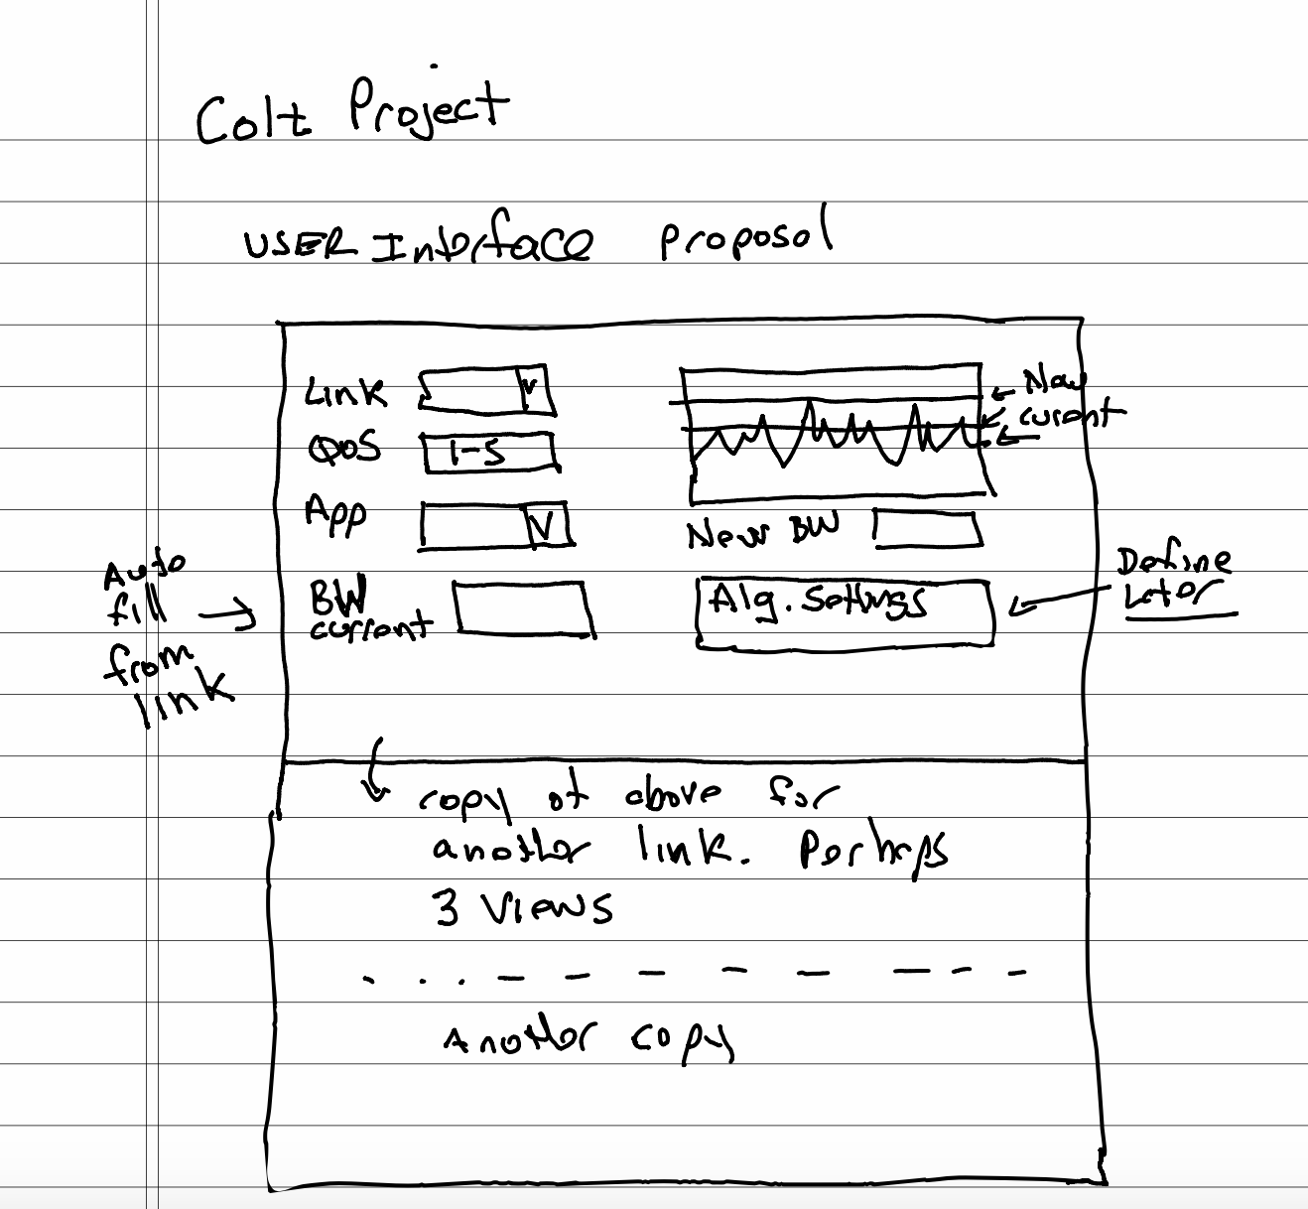
UPDATED UI (Colt) Perspective

Slide 13
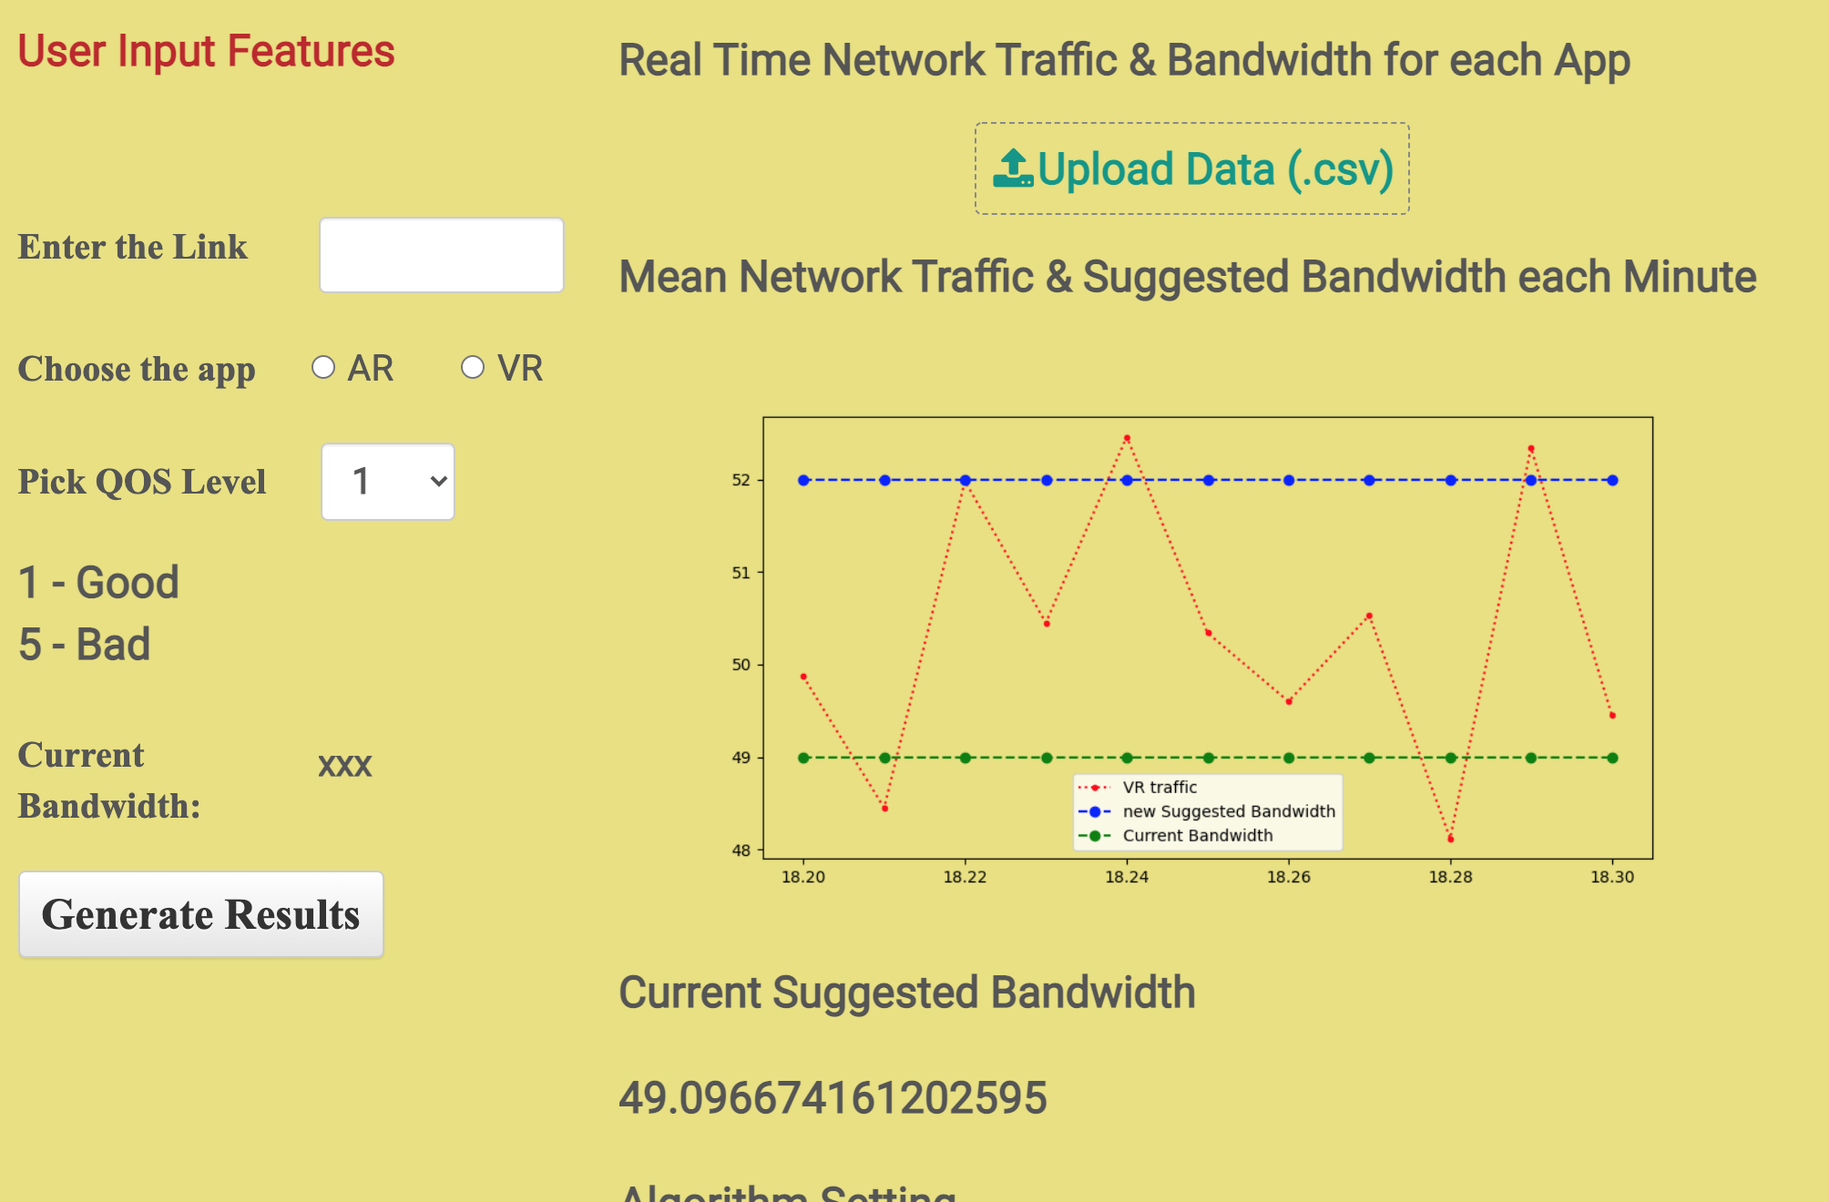

Slide 14
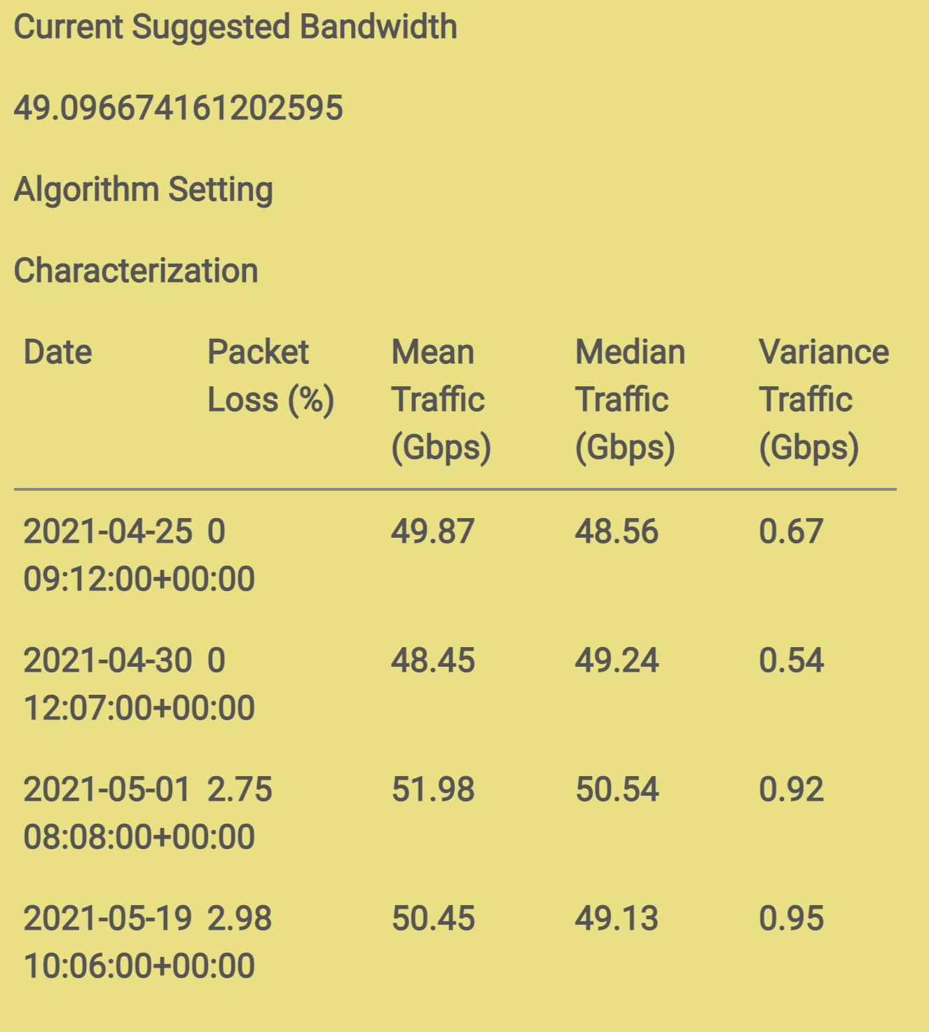

Slide 15
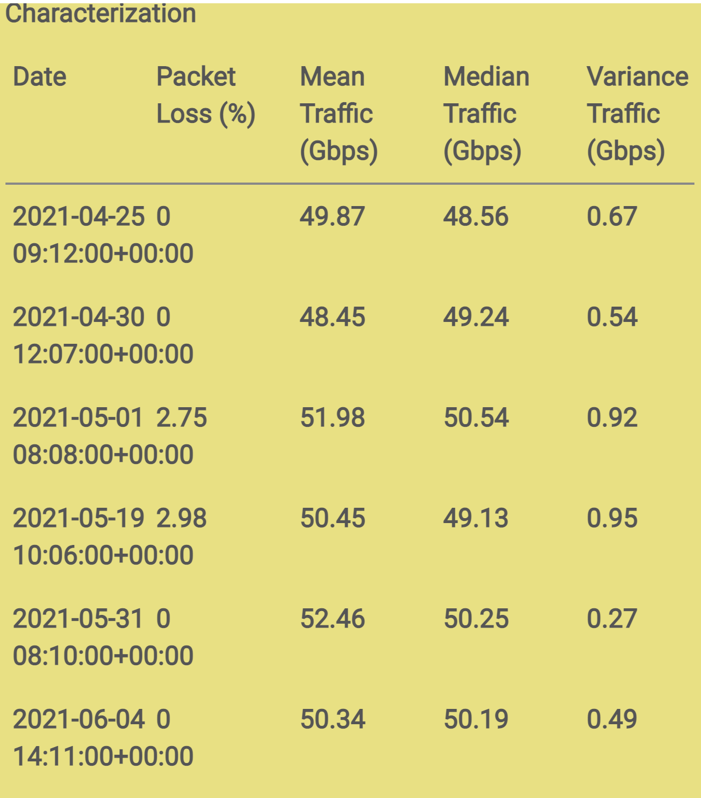

Slide 16
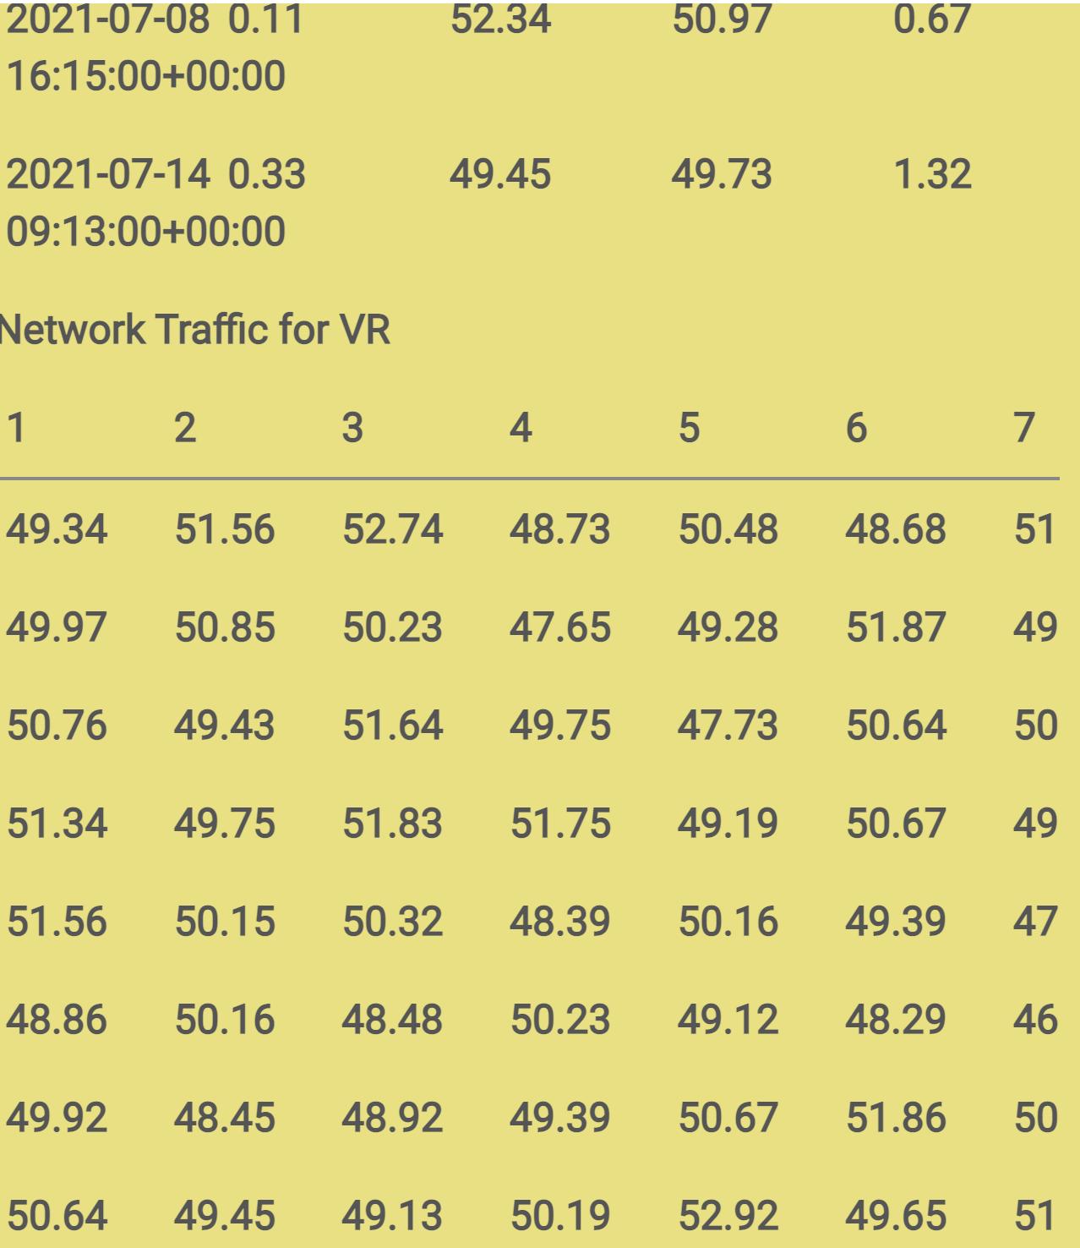

Slide 17
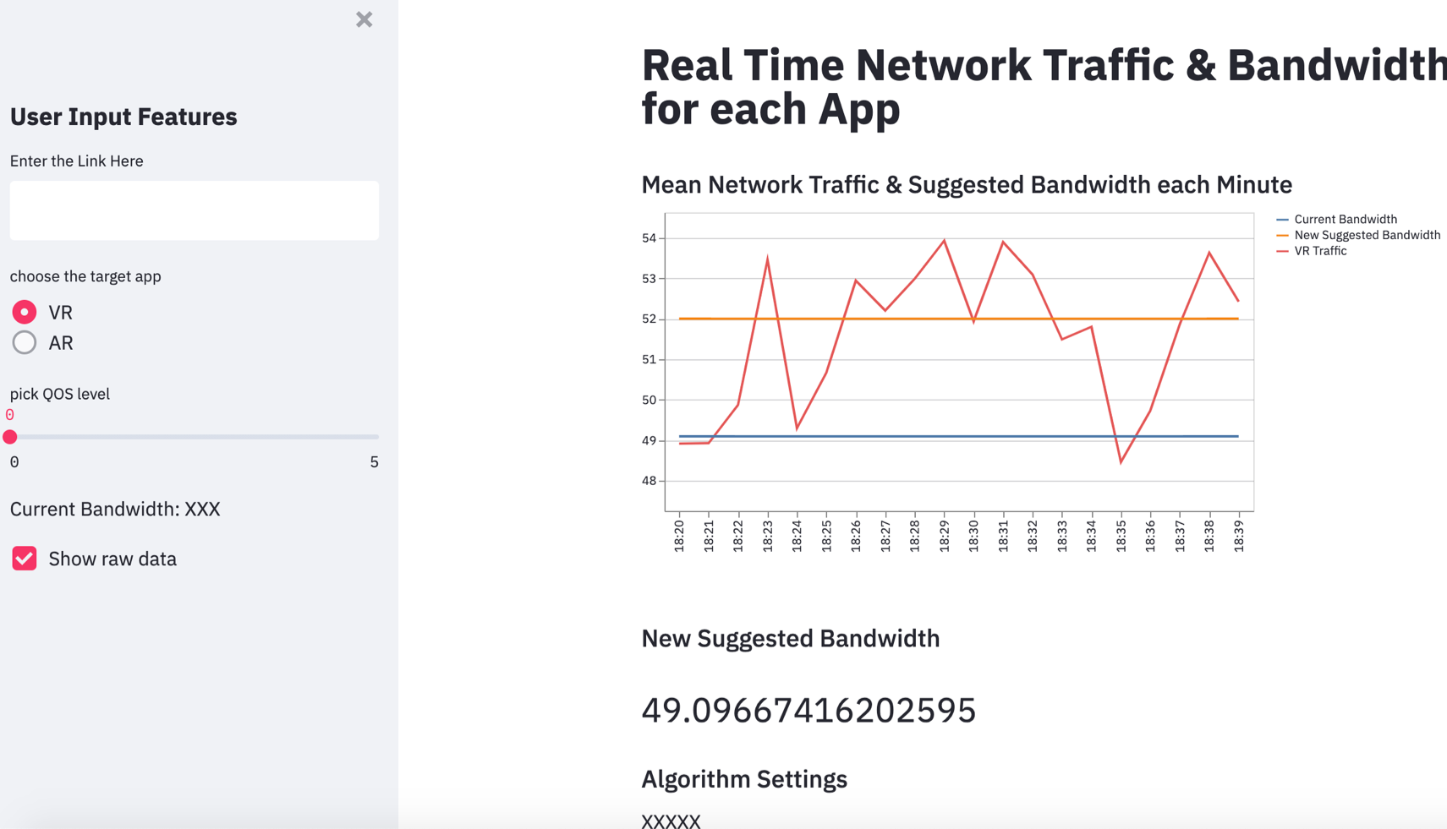
UPDATED UI (Colt) Perspective

Slide 18
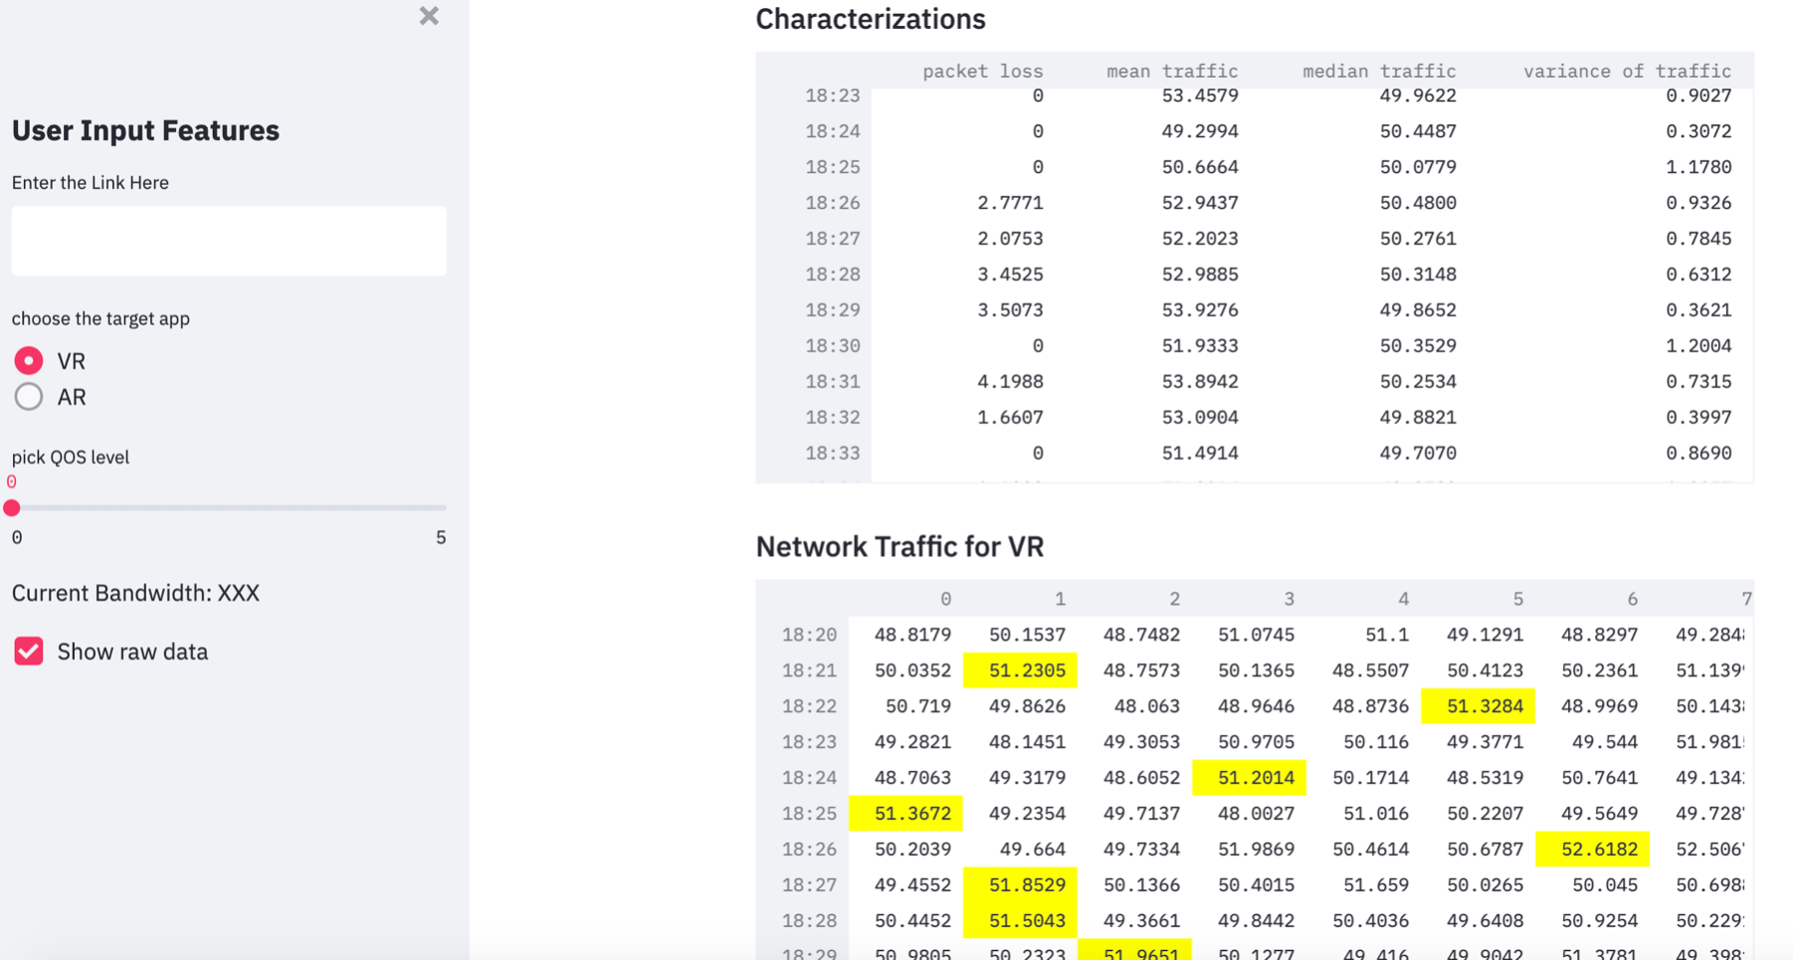
UPDATED UI (Colt) Perspective

Slide 19
Rough draft slides

Slide 20
Compare to other UI’s
 | Flexibility / Speed of Iteration | Ease of Use / Learning Curve | Performance. How does it scale with more usage | Overall rating Effectiveness for Problem
Tool/Tech Option 1 | 1 minute | Easy use for COLT to navigate | 3 | 10
Tool/Tech Option 2 | 1 hour | Medium- Complex UI system | 5 | 9
Tech/Tool Option 3 | 1 day | Hard-Very Complex UI system | 7 | 8

Slide 21
Compare to other options
Example: facial recognition
 | Flexibility / Speed of Iteration | Ease of Use / Learning Curve | Performance. How does it scale with more usage | Overall rating Effectiveness for Problem
Tool/Tech Option 1 | AR | easy | low
Tool/Tech Option 2 | VR | alright | medium
Tech/Tool Option 3 |  | hard | high
Which of these options is best for “speed of iteration” and simplicity to use?
Notes:
My experience was learning new tools, which will you need python, Java and familiarity with UI to build and use the dashboard.
My experience was learning new tools, which will you need python, Java and familiarity with UI to build and use the dashboard. Yes, I would recommend to others, since learning these tools will help in your career

